Slide 1
Object Oriented Programming
Week 6
Abeer GAUHER
Email: abeer.gauher@nu.edu.pk
Office: CS BASEMENT 2, Office number 17

Slide 2
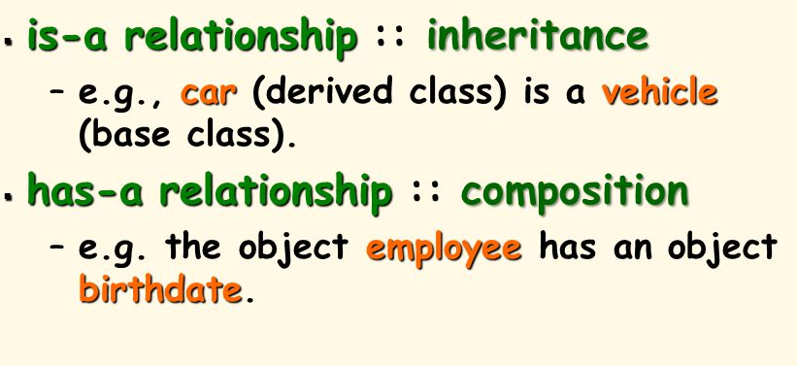
Object Relationship
is-a relationship
has-a relationship

Slide 3
has-a Relationship
In a has-a relationship, an object contains one or more objects of other classes as members.
A car has a steering. An office has a department.

Slide 4
has-a Relationship
class Office
{
Department d;
// any other members
};

Slide 5
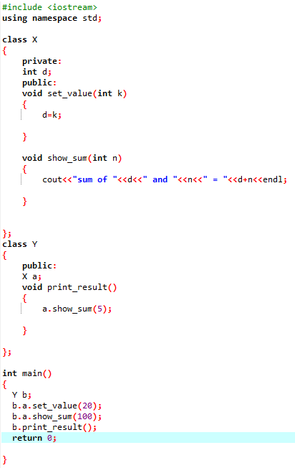

has-a Relationship Example
Class X has one data member ‘d’ and two member functions ‘set_value()’ and ‘show_sum()’.
set_value() function is used to assign value to ‘d’.
show_sum() function uses an integer type parameter.
Class Y has an object of class x that is Composition. This class has its own member function print_result().
In the main() function, an object ‘b’ of class y is created. The member function set_value() of object ‘a’ that is the sub-object of object ‘b’ is called by using two dot operators. One dot operator is used to access the member of the object ‘b’ that is object ‘a’, and second is used to access the member function set_value() of sub-object ‘a’ and ‘d’ is assigned a value 20.

Slide 6
has-a Relationship Example
In the same way, the show_sum() member function is called by using two dot operators.
The value 100 is also passed as a parameter.
The member function print_result of object ‘b’ of class Y is also called for execution.
In the body of this function, the show_sum() function of object ‘a’ of class X is called for execution by passing value 5.

Slide 7
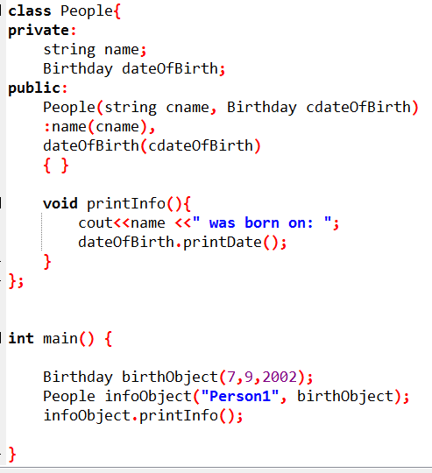
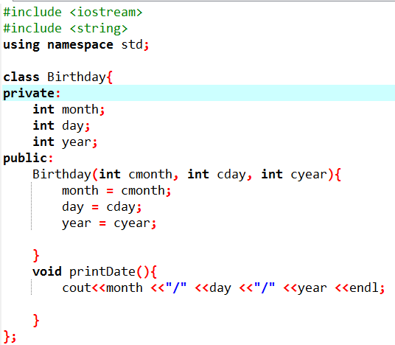
has-a Relationship Example

Slide 8
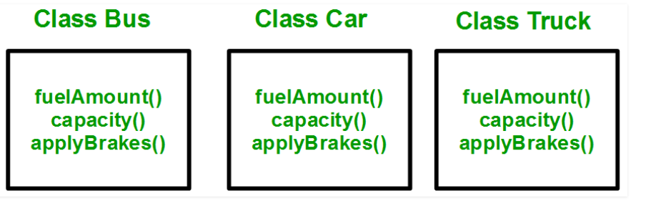
Why do we need Inheritance?
Consider a group of vehicles. Need to create classes for Bus, Car and Truck.
The methods fuelAmount(), capacity(), applyBrakes() will be same for all of the three classes.
If we create these classes avoiding inheritance then we have to write all of these functions in each of the three classes.

Slide 9
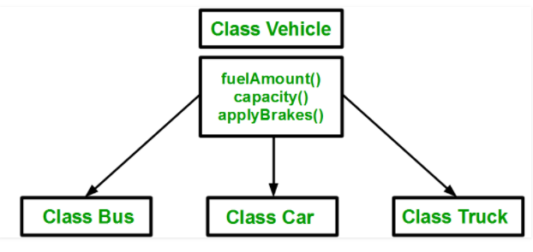
Why do we need Inheritance?
Create a class Vehicle and write these three functions in it and inherit the rest of the classes from the vehicle class, then we can simply avoid the duplication of data and increase re-usability.

Slide 10
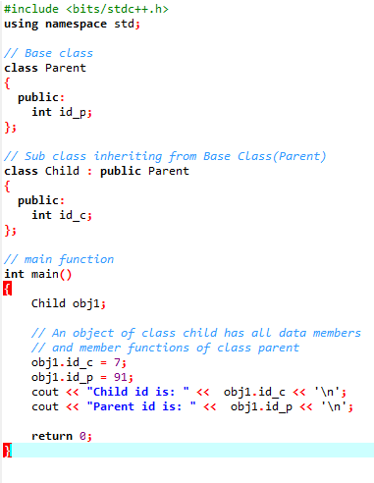

Simple Example

Slide 11
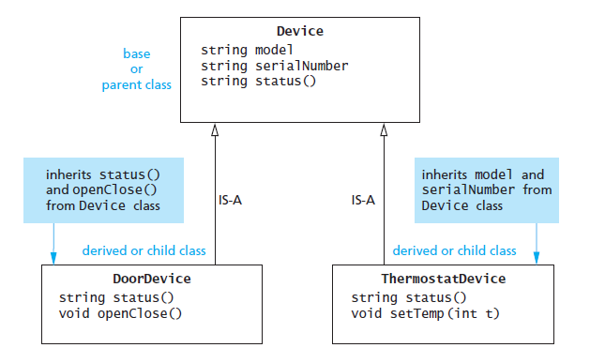
is-a Relationship
Sometimes, one class is an extension of another class.
A car is a vehicle Cricket is a sport

Slide 12
is-a Relationship
The extended (or child) class contains all the features of its base (or parent) class, and may additionally have some unique features of its own.
The key idea behind inheritance.

Slide 13
Example – “IS A” Relationship
Person
name
age
gender
eat
walk
Student
Teacher
Doctor
program
studyYear
designation
salary
designation
salary
study
heldExam
teach
takeExam
checkUp
prescribe

Slide 14
Example – “IS A” Relationship
Shape
color
coord
draw
rotate
setColor
Triangle
Circle
radius
Line
angle
draw
computeArea
length
draw
computeArea
draw

Slide 15
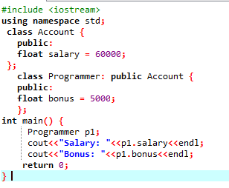

is-a Relationship

Slide 16
Inheritance
A form of software reusability where a class inherits an existing class’ behavior and enhances it by adding more functionalities.
The existing class is called base class (or sometimes super class) and the new class is referred to as derived class (or sometimes sub class).

Slide 17
Example
The is-a relationship represents inheritance.
The car is a vehicle, so any attributes and behaviors of a vehicle are also attributes and behaviors of a car.

Slide 18
Example
class Vehicle { // data members of base class }
class Car: public Vehicle {
//data members of derived class }

Slide 19
Base & Derived Classes
Every derived-class object is also an object of its base class, and one base class can have many derived classes.
A derived class can access all non-private members of its base class.

Slide 20
Visibility of Base Class Members
A derived class can use the access modifiers public, protected or private to restrict access to its base class members.
In all situations, a derived class can never access private members of its base class.

Slide 21
Public Inheritance
The use of access modifier public in derived class header
Example: class myDerived: public myBase
{
// derived class members }

Slide 22
Public Inheritance
In public inheritance:
The public members of a base class are treated as public members of the derived class by other classes further down the hierarchy.
The protected members of a base class are treated as protected members of the derived class by other classes further down the hierarchy.

Slide 23
Public Inheritance
class GrandChild: public Child
{ // can never access a directly
// can access b directly // can access c directly }
class Parent {
private: int a; public: int b;
protected: int c; }
class Child: public Parent { // can never access a directly // can access b & c directly }

Slide 24
Protected Inheritance
The use of access modifier protected in derived class header.
Example: class myDerived: protected myBase
{
// derived class members }

Slide 25
Protected Inheritance
In protected inheritance:
The public members of a base class are treated as protected members of the derived class by other classes further down the hierarchy.
The protected members of a base class are treated as protected members of the derived class by other classes further down the hierarchy.

Slide 26
Protected Inheritance
class GrandChild: public Child
{ // can never access a directly
// can access b directly // can access c directly }
class Parent {
private: int a; public: int b;
protected: int c; }
class Child: protected Parent { // can never access a directly // can access b & c directly }

Slide 27
Private Inheritance
The use of access modifier private in derived class header
Example: class myDerived: private myBase
{
// derived class members }

Slide 28
Private Inheritance
In private inheritance:
All public & protected members of a base class are treated as private members of the derived class by other classes further down the hierarchy.
In other words, these members can be seen as locked and cannot be accessed further down the hierarchy.

Slide 29
Private Inheritance
class GrandChild: public Child
{ // can never access a directly
// cannot access b directly // cannot access c directly }
class Parent {
private: int a; public: int b;
protected: int c; }
class Child: private Parent { // can never access a directly // can access b & c directly }

Slide 30
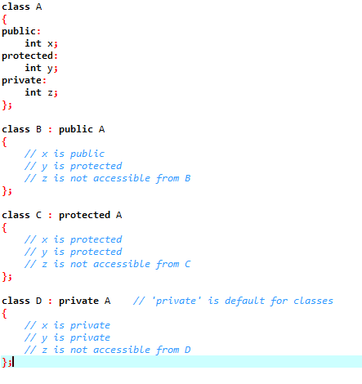
Inheritance

Slide 31
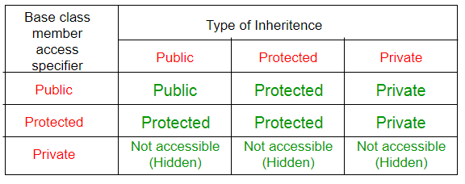
Inheritance

Slide 32
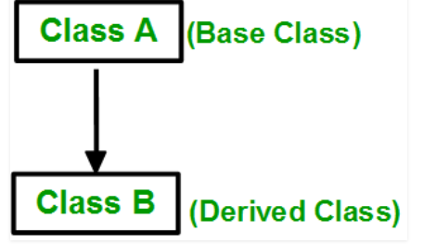
Types of Inheritance
Single Inheritance: In single inheritance, a class is allowed to inherit from only one class. i.e. one sub class is inherited by one base class only.
Syntax:
class subclass_name : access_mode base_class
{
// body of subclass
};

Slide 33
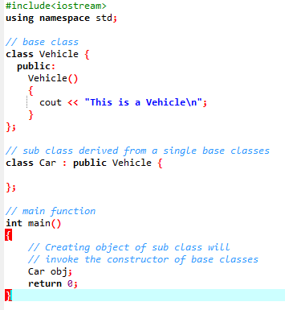
Types of Inheritance
Single Inheritance:

Slide 34
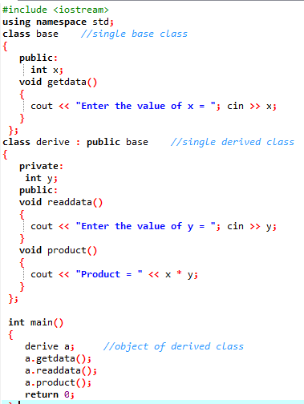

Types of Inheritance
Single Inheritance:

Slide 35
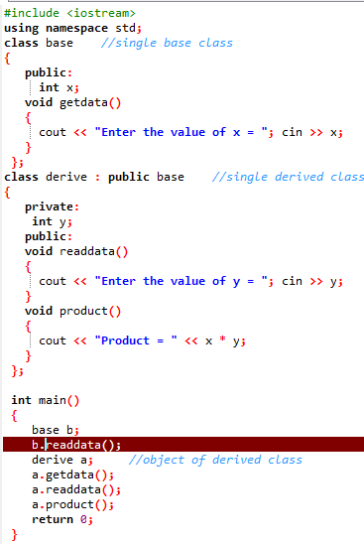
Types of Inheritance
Single Inheritance:

Slide 36
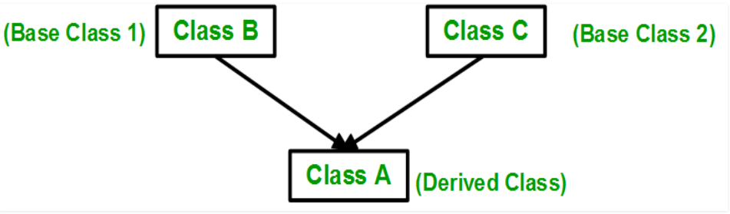
Types of Inheritance
Multiple Inheritance: Multiple Inheritance is a feature of C++ where a class can inherit from more than one classes. i.e one sub class is inherited from more than one base classes.
class subclass_name : access_mode base_class1, access_mode base_class2, ....
{
// body of subclass
};

Slide 37
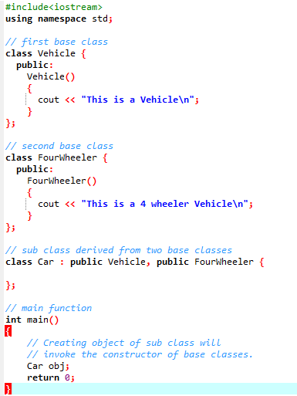

Types of Inheritance
Multiple Inheritance:

Slide 38
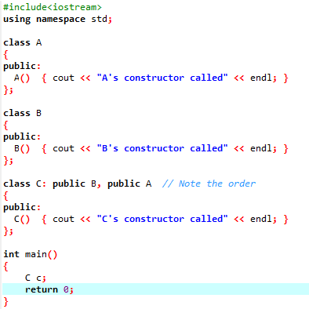

Types of Inheritance
Multiple Inheritance:
The constructors of inherited classes are called in the same order in which they are inherited. For example, in the following program, B’s constructor is called before A’s constructor.

Slide 39
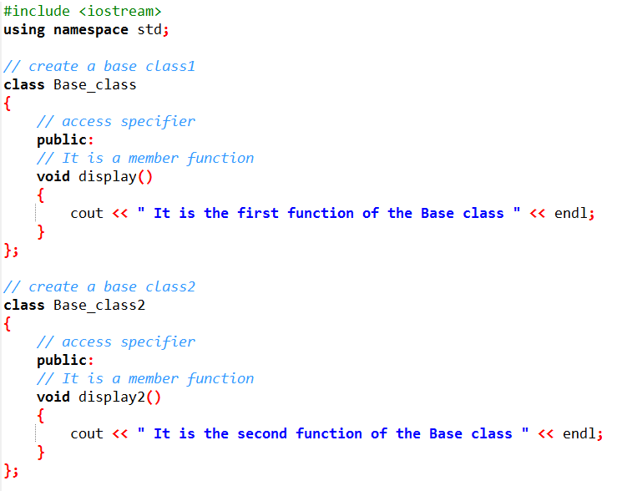
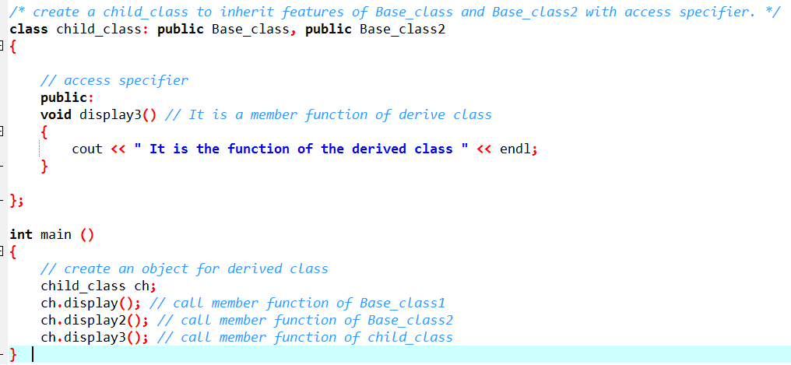

Types of Inheritance
Multiple Inheritance:

Slide 40
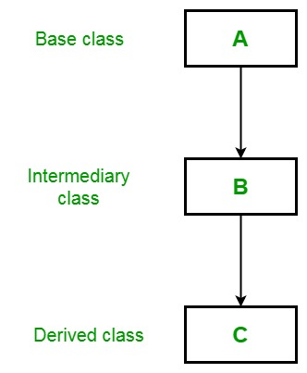
Types of Inheritance
Multilevel Inheritance: In this type of inheritance, a derived class is created from another derived class.
Class A {
Statements of Class A
};
Class B: public class A {
Statements of Class b
};
Class C: public class B {
Statements of Class C
};

Slide 41
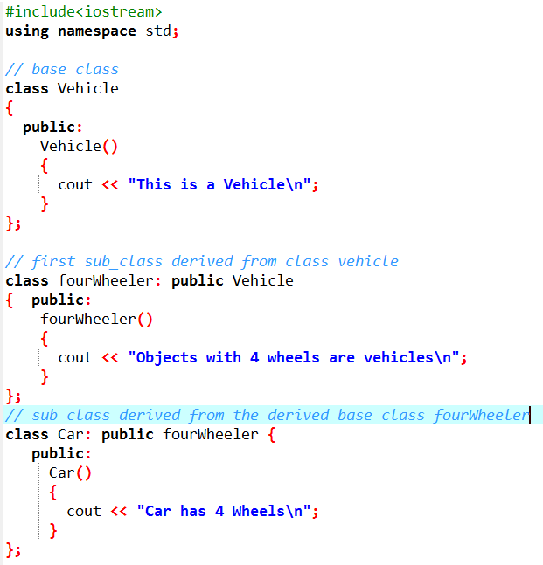
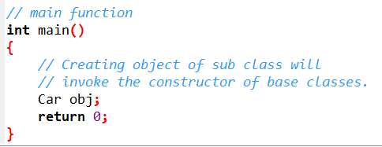

Types of Inheritance
Multilevel Inheritance:

Slide 42
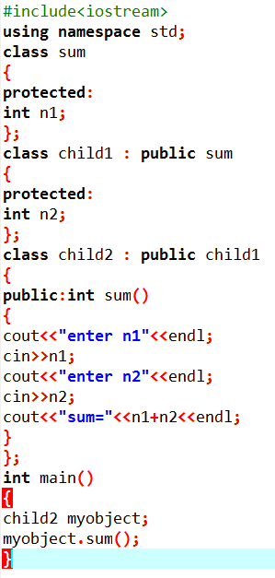

Types of Inheritance
Multilevel Inheritance:

Slide 43
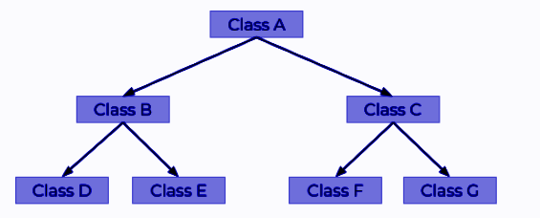
Types of Inheritance
Hierarchical Inheritance: In this type of inheritance, more than one sub class is inherited from a single base class. i.e. more than one derived class is created from a single base class.
Class A {
Statements of Class A
};
Class B: public class A {
Statements of Class b
};
Class C: public class B {
Statements of Class C
};

Slide 44
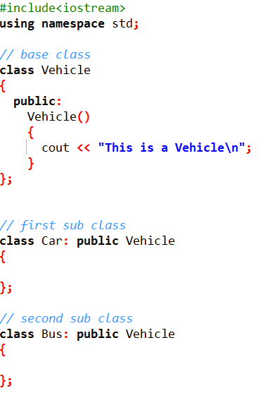
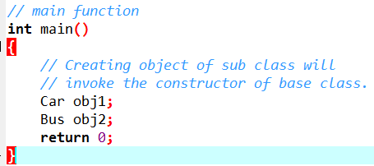

Types of Inheritance
Hierarchical Inheritance:

Slide 45
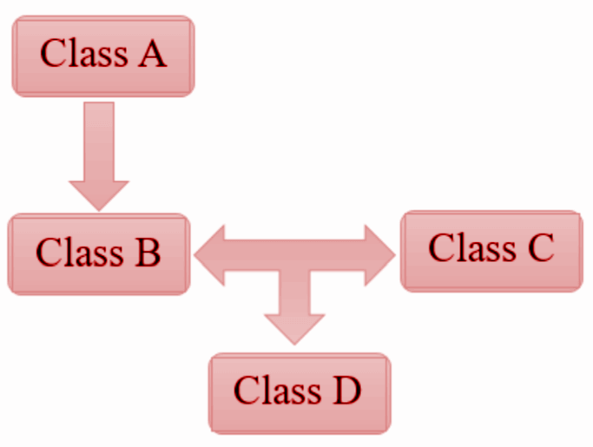
Types of Inheritance
Hybrid Inheritance:
In hybrid inheritance, there is a combination of one or more inheritance types.
For instance, the combination of single and hierarchical inheritance.
Therefore, hybrid inheritance is also known as multipath inheritance.

Slide 46
Types of Inheritance
Hybrid Inheritance:
Class A
{
statement(s)
}:
Class B: public A
{
statement(s);
};
Class C
{
statement(s);
};
Class D: public B, public C
{
statement(s);
};
Combination of single inheritance and multiple inheritance.
Single inheritance - Class B inherits class A.
Multiple inheritance - Class D is inherited from multiple classes.

Slide 47
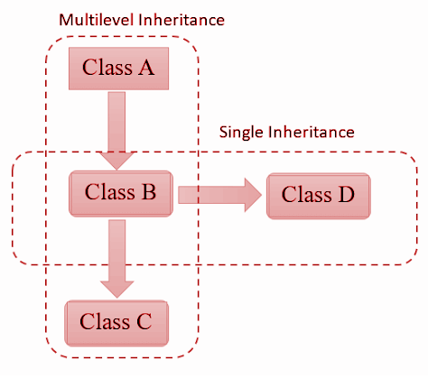
Types of Inheritance
Hybrid Inheritance:
Class A
{
statement(s);
};
Class B: public A
{
statement(s);
};
Class C: public B
{
statement(s);
};
Class D: public B
{
statement(s);
};
Multilevel inheritance - Class B inherits class A and class C inherits class B.
Single inheritance - From the above diagram, Class D inherits class B.

Slide 48
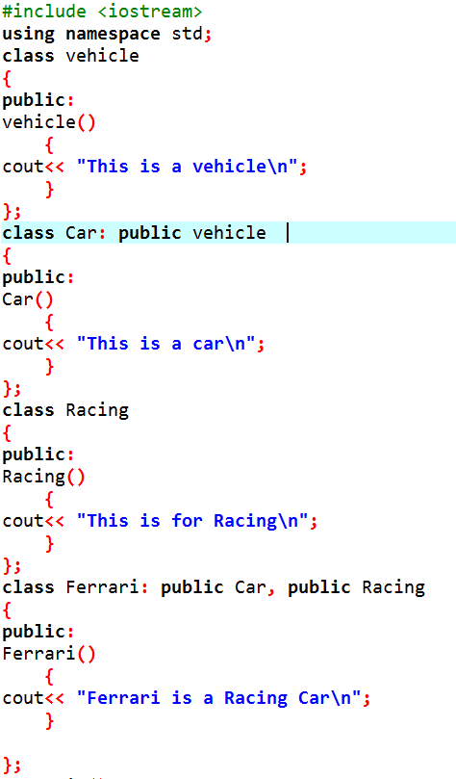

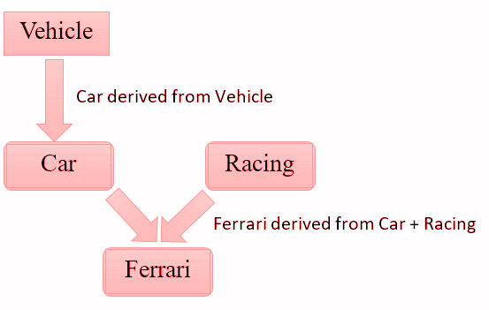

Types of Inheritance
Hybrid Inheritance:

Slide 49
Inheritance (Parameterized constructor)
A constructor in a base class is not inherited in the derived class, but you can invoke a constructor of the base class within the definition of a derived class constructor.
A constructor for the base class initializes all the data inherited from the base class.
A constructor for a derived class begins with an invocation of a constructor for the base class.

Slide 50
Inheritance (Parameterized constructor)
IMPORTANT:
If we inherit a class from another class and create an object of the derived class, it is clear that the default constructor of the derived class will be invoked but before that the default constructor of all of the base classes will be invoke, i.e the order of invocation is that the base class’s default constructor will be invoked first and then the derived class’s default constructor will be invoked.

Slide 51
Inheritance (Parameterized constructor)
Why the base class’s constructor is called on creating an object of derived class?
What happens when a class is inherited from other? The data members and member functions of base class comes automatically in derived class based on the access specifier but the definition of these members exists in base class only.
So when we create an object of derived class, all of the members of derived class must be initialized but the inherited members in derived class can only be initialized by the base class’s constructor as the definition of these members exists in base class only.

Slide 52
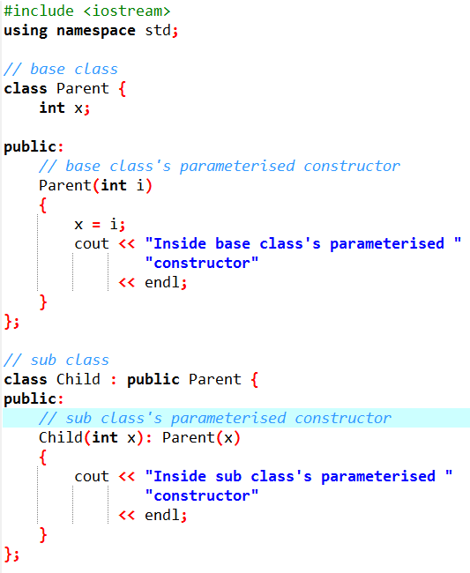
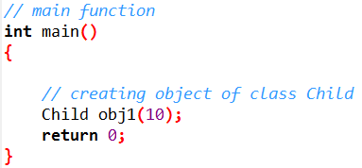
Inheritance (Parameterized constructor)

Slide 53
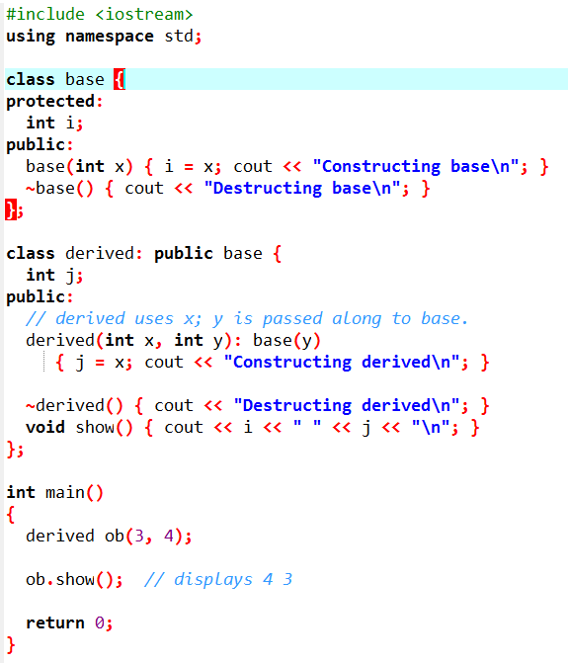

Inheritance (Parameterized constructor)
Derived's constructor is declared as taking two parameters, x and y.
Derived() uses only x; y is passed along to base().
The constructor of the derived class must declare the parameter(s) that its class requires, as well as any required by the base class.
Parameters required by the base class are passed to it in the base class' argument list, specified after the colon.

Slide 54
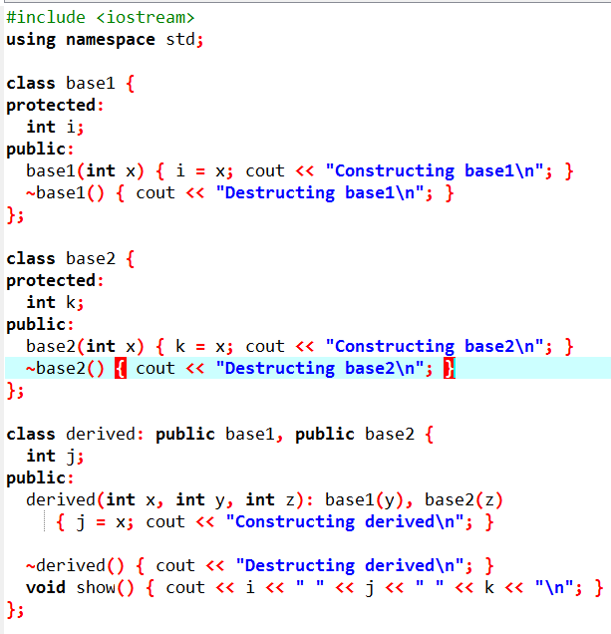
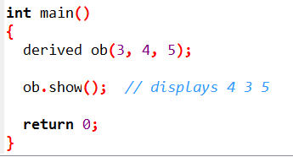

Inheritance (Parameterized constructor)
Derived's constructor is declared as taking two parameters, x and y.
Derived() uses only x; y is passed along to base().
The constructor of the derived class must declare the parameter(s) that its class requires, as well as any required by the base class.
Parameters required by the base class are passed to it in the base class' argument list, specified after the colon.

Slide 55
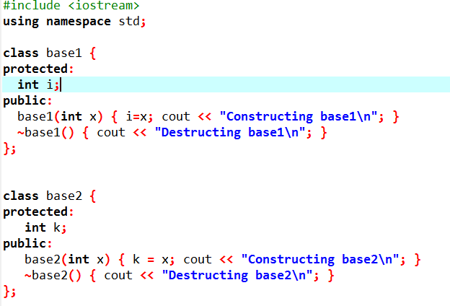
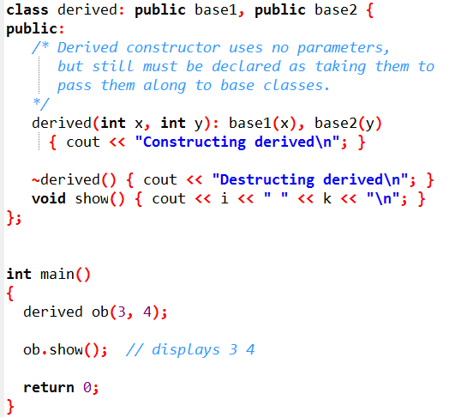
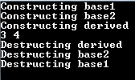
Inheritance (Parameterized constructor)
Even if a derived class' constructor does not use any arguments, it still must declare one or more arguments if the base class takes one or more arguments.
The arguments passed to the derived class are simply passed along to the base.
Derived's constructor is declared as taking two parameters, x and y.

Slide 56
Destructors
When the destructor for the derived class is invoked, it automatically invokes the destructor of the base class, so there is no need for the explicit writing of a call to the base class destructor; it always happens automatically.
The derived class destructor therefore need only worry about using delete on the member variables (and any data they point to) that are added in the derived class.
It is the job of the base class destructor to invoke delete on the inherited member variables.

Slide 57
Destructors
Class A{
Then destructor of class A is called
};
Class B : Class A{
Then destructor of class B is called
};
Class C: Class B{
First destructor of class c is called
};
If class B is derived from class A and class C is derived from class B, then when an object of the class C goes out of scope, first the destructor for the class C is called, then the destructor for class B is called, and finally the destructor for class A is called.
Note that the order in which destructors are called is the reverse of the order in which constructors are called.

Slide 58
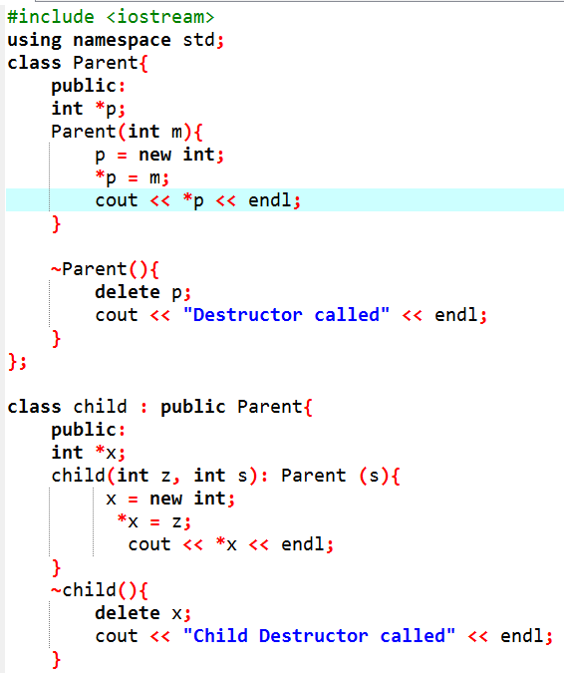


Destructors

